Slide 1
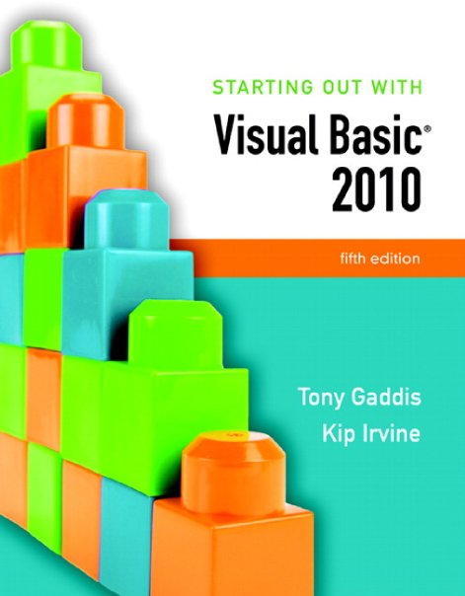

Slide 2
Chapter 7
Multiple Forms, Modules,
and Menus

Slide 3
Introduction
This chapter demonstrates how to:
Add multiple forms to a project
Create a module to hold procedures and functions
Create a menu system with commands and submenus
Create context menus that appear when the user right-clicks on an item

Slide 4
Multiple Forms
Section 7.1
Visual Basic projects can have multiple forms. The startup form is
the form that is displayed when the project executes. Other forms
in a project are displayed by programming statements.

Slide 5
Windows Forms Applications
Windows Forms applications are not limited to only a single form
You may create multiple forms
To use as dialog boxes
Display error messages
And so on
Windows Forms applications typically have one form called the startup form
Automatically displayed when the application starts
Assigned to the first form by default
Can be assigned to any form in the project

Slide 6
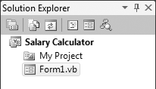
Form Files and Form Names
Each form has a Name property
Set to Form1 by default
Each form also has a file name
Stores the code associated with the form
Viewed in the Code window
Has the same name as the form
Followed by the .vb extension
Shown in the Solution Explorer window

Slide 7
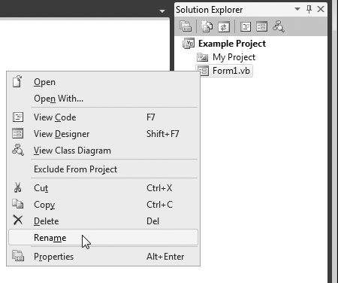
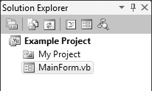
Renaming an Existing Form File
Always use the Solution Explorer window to change the file name and the form’s Name property will change automatically
To rename a form file:
Right-click file name in Solution Explorer
Select Rename from the menu
Type the new name for the form
Be sure to keep the .vb extension
Remember to
give each form
a meaningful name

Slide 8
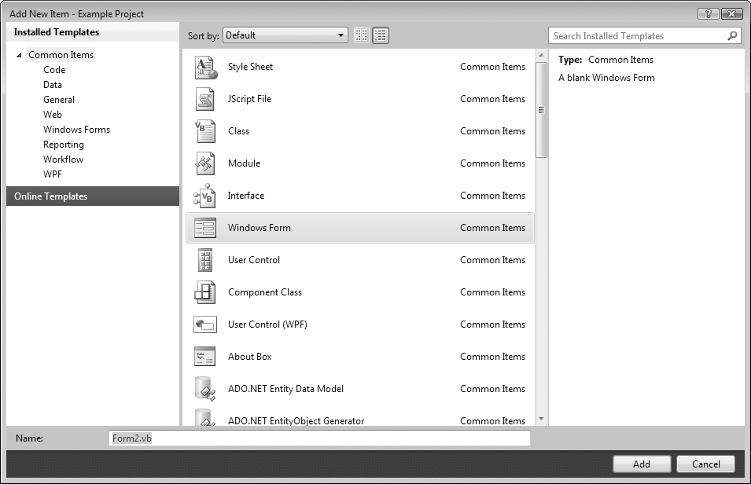
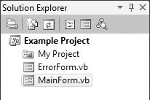
Adding a New Form to a Project
To add a new form to a project:
Click Project on the Visual Studio menu bar, and then select Add Windows Form . . . The Add New Item window appears
Enter the new Name
in the Name text box
Click the Add button
A new blank form is
added to your project

Slide 9
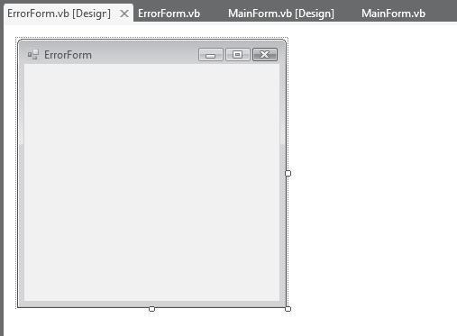
Switching between Forms and Form Code
To switch to another form:
Double-click the form’s entry in the Solution Explorer window
To switch between forms or code:
Use the tabs along the top of the Designer window
Form
Code
Form
Code
Switching only works at design time

Slide 10
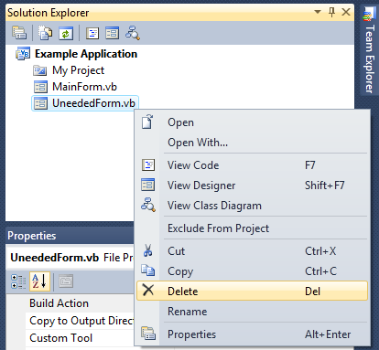
Removing a Form
To remove a form from a project and delete its file from the disk:
Right-click the form’s entry in the Solution Explorer window
On the pop-up menu, click Delete
To remove a form from a project but leave its file on disk*:
Right-click the form’s entry in the Solution Explorer window
On the pop-up menu, click Exclude From Project
*Not available in Visual Basic Express

Slide 11
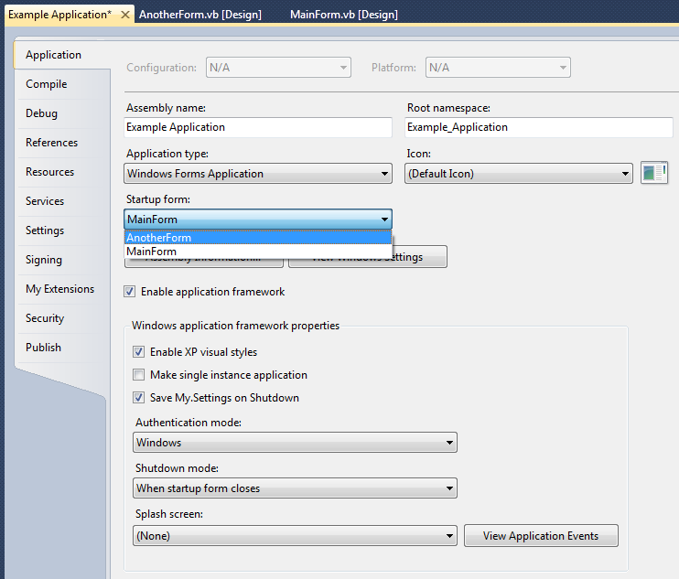
Designating the Startup Form
To make another form the startup form:
Right-click the project name in the Solution Explorer window
On the pop-up menu, click Properties, the properties page appears
Select the Application tab
Click the down arrow in the Startup Form drop-down list
Select a form from the list of available forms

Slide 12
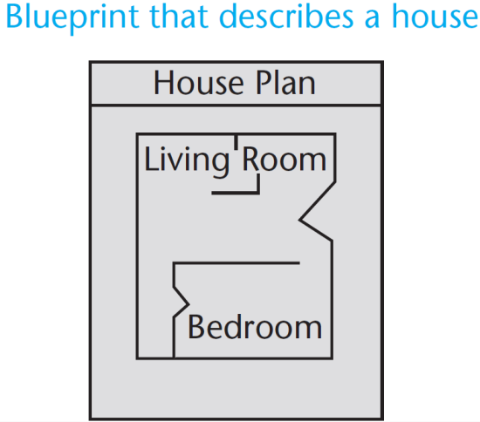
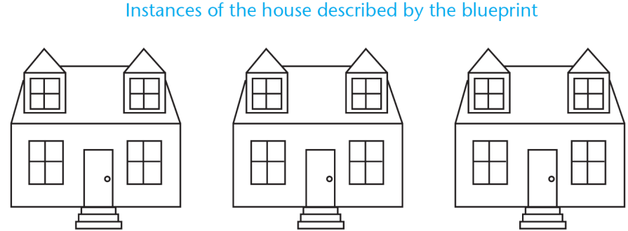
Creating an Instance of a Form
The form design is a class
It’s only a design or description of a form
Think of it like a blueprint
A blueprint is a detailed description of a house
A blueprint is not a house
The form design can be used to create instances of the form
Like building a house from the blueprint
To display a form, we must first create an instance of the form
Public Class FormName
End Class

Slide 13
Displaying a Form
The first step is to create an instance of the form with the Dim statement
Here is the general format:
ObjectVariable is the name of an object variable that references an instance of the form
An object variable
Holds the memory address of an object
Allows you to work with the object
ClassName is the form’s class name
The following statement creates an instance of the ErrorForm form in memory:
frmError variable references the ErrorForm object
Statement does not cause the form to be displayed on the screen
To display the form on the screen:
Use the object variable to invoke one of the form’s methods
Dim ObjectVariable As New ClassName
Dim frmError As New ErrorForm
The prefix frm is used to indicate that the variable references a form

Slide 14
The ShowDialog and Show Methods
If a modal form is displayed:
No other form in the application can receive the focus until the form is closed
The ShowDialog method causes a form to be displayed as a modal form
Here is the general format:
For example:
If a modeless form is displayed:
The user is allowed to switch focus to another form while it is displayed
The Show method causes a form to be displayed as a modeless form
Here is the general format:
For example:
ObjectVariable.ShowDialog()
ObjectVariable.Show()
Dim frmError As New ErrorForm
frmError.ShowDialog()
Dim frmError As New ErrorForm
frmError.Show()

Slide 15
Closing a Form with the Close Method
The Close method closes a form and removes its visual part from memory
A form closes itself using the keyword Me
For example:
Causes the current instance of the form to call its own Close method, thus closing the form
Me.Close()
The word Me in Visual Basic is a special variable that references the currently executing object

Slide 16
The Hide Method
The Hide method
Makes a form or control invisible
Does not remove it from memory
Similar to setting the Visible property to False
A form uses the Me keyword to call its own Hide method
For example:
To redisplay a hidden form:
Use the ShowDialog or Show methods
Tutorial 7-1 creates a simple application that has two forms
Me.Hide()

Slide 17
More on Modal and Modeless Forms
When a procedure calls the ShowDialog method
Display of a modal form causes execution of calling statements to halt until form is closed
When a procedure calls the Show method
Display of a modeless form allows execution to continue uninterrupted
Tutorial 7-2 demonstrates this difference between modal and modeless forms
statement
statement
frmMessage.Show()
statement Go!
statement Go!
statement Go!
statement
statement
frmMessage.ShowDialog()
statement Halt!
statement Halt!
statement Halt!

Slide 18
The Load Event
The Load event is triggered just before the form is initially displayed
Any code needed to prepare the form prior to display should be in the Load event
If some controls should not be visible initially, set their Visible property in the Load event
Double click on a blank area of the form to set up a Load event as shown below
Private Sub MainForm_Load(…) Handles MyBase.Load
End Sub

Slide 19
The Activated Event
The Activated event occurs when the user switches to the form from another form or application
To create an Activated event handler, follow these steps:
Click the class drop-down list, which appears at the top left of the Code window
On the drop-down list, select (FormName Events), where FormName is the name of the form
Click the method drop-down list, which appears at the top right of the Code window, and select Activated
After completing these steps, a code template for the Activated event handler is created in the Code window

Slide 20
The FormClosing Event
The FormClosing event is triggered as the form is being closed, but before it has closed
The FormClosing event can be used to ask the user if they really want the form closed
To create an FormClosing event handler, follow these steps:
Click the class drop-down list, which appears at the top left of the Code window
On the drop-down list, select (FormName Events), where FormName is the name of the form
Click the method drop-down list, which appears at the top right of the Code window, and select FormClosing
After completing these steps, a code template for the FormClosing event handler is created in the Code window

Slide 21
The FormClosed Event
The FormClosed event occurs after a form has closed.
Create a FormClosed event handler by following these steps:
Click the class drop-down list, which appears at the top left of the Code window
On the drop-down list, select (FormName Events), where FormName is the name of the form
Click the method drop-down list, which appears at the top right of the Code window, and select FormClosed
After completing these steps, a code template for the FormClosed event handler is created in the Code window
You cannot prevent a form from closing with the FormClosed event handler.
You must use the FormClosing event handler to prevent a form from closing.

Slide 22
Accessing Controls on a Different Form
Once you have created an instance of a form, you can access controls on that form in code
The following code shows how you can
Create an instance of a form
Assign a value to the form’s label control’s Text property
Display the form in modal style
Tutorial 7-3 demonstrates accessing controls on a different form
Dim frmGreetings As New GreetingsForm
frmGreetings.lblMessage.Text = "Good day!"
frmGreetings.ShowDialog()

Slide 23
Class-Level Variables in a Form
Class-level variables are declared Private by the Dim statement
Private variables are not accessible by code in other forms
Use the Public keyword to make a class-level variable available to methods outside the class
Explicitly declare class-level variables with the Private keyword to make your source code more self-documenting
Dim dblTotal As Double ' Class-level variable
Public dblTotal As Double ' Class-level variable
Private dblTotal As Double ' Class-level variable

Slide 24
Using Private and Public Procedures in a Form
Procedures, by default, are Public
They can be accessed by code outside their form
To make a procedure invisible outside its own form, declare it to be Private
You should always make the procedures in a form private
Unless you specifically want statements outside the form to execute the procedure

Slide 25
Using a Form in More Than One Project
After a form has been created and saved to a file, it may be used in other projects
Follow these steps to add an existing form to a project:
With the receiving project open in Visual Studio, click Project on the menu bar, and then click Add Existing Item
The Add Existing Item dialog box appears
Locate the form file that you want to add to the project, select it and click the Open button
A copy of the form is now added to the project

Slide 26
Modules
Section 7.2
A module contains code—declarations and procedures—that are
used by other files in a project.

Slide 27
What is a Module?
A module is a Visual Basic file that contains only code
General purpose procedures, functions, and declarations of variables and constants
Can be accessed by all forms in the same project
No event handlers
Stored in files that end with the .vb extension
Appears in the Solution Explorer along with entries for the project’s form files

Slide 28
Module Names and Module Files
A module
begins with a Module statement
ends with an End Module statement
Here is the general format:
ModuleName is the name of the module
Can be any valid identifier
That describes its purpose
Code is stored in a file that is named with the .vb extension
Normally, the name of the file is the same as the name of the module
Module ModuleName
[Module Contents]
End Module

Slide 29
Example Module
The following code shows the contents of a module named RetailMath
Module RetailMath
' Global constant for the tax rate
Public Const decTAX_RATE As Decimal = 0.07D
' The SalesTax function returns the sales tax on a purchase.
Public Function SalesTax(ByVal decPurchase As Decimal) As Decimal
Return decPurchase * decTAX_RATE
End Function
End Module

Slide 30
Adding a Module
Follow these steps to add a module to a project:
Click Project on the menu bar and then click Add Module. The Add New Item windows appears
Change the default name that appears in the Name text box to the name you wish to give the new module file
Click the Add button
A new empty module will be added to your project
The module is displayed in the Code window
An entry for the module appears in the Solution Explorer window

Slide 31
Module-Level Variables
A module-level variable is a variable that is declared inside a module, but not inside a procedure or function
The same rules about the scope of class-level variables in a form apply to module-level variables in a module
Variables with module scope are declared with Dim or Private
Accessible to any function or procedure in the module
Not accessible to statements outside of the module
A global variable is declared with the Public keyword
Accessible to any statement in the application
Some programmers prefix global variables with g_
Tutorial 7-4 examines an application that uses a module
Public g_decPurchaseAmount As Decimal ' Global variable

Slide 32
Using a Module in More Than One Project
It is possible to use more than one module in a project
Suppose you want to add an existing module to a new project
Follow these steps to add an existing standard module to a project:
Click Project on the menu bar, and then click Add Existing Item. The Add Existing Item dialog box appears
Use the dialog box to locate the module file you want to add to the project. When you locate the file, select it and click the Open button
The module is now added to the project

Slide 33
Menus
Section 7.3
Visual Basic allows you to create a system of drop-down menus for
any form in your application. You use the menu designer to create a
menu system.

Slide 34
Menu Systems
A menu system is a collection of commands organized in one or more drop-down menus
commonly used when an application has several options for the user to choose from
The menu designer allows you to visually create a custom menu system
for any form in an application

Slide 35
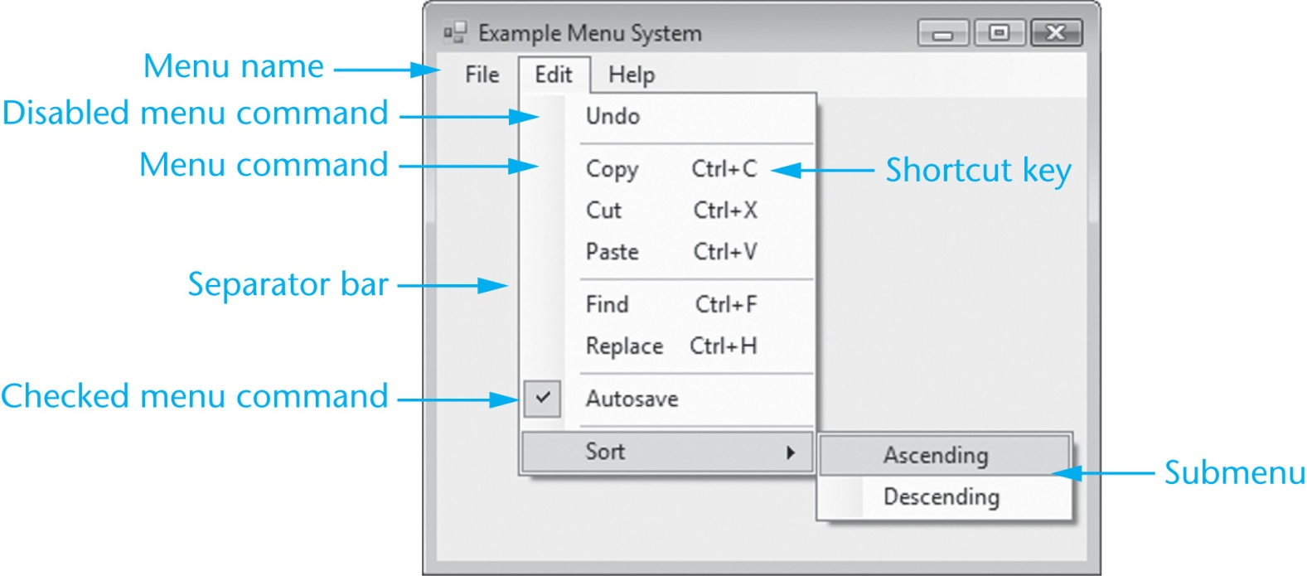
Components of a Menu System
Each drop-down menu has a menu name
Each drop-down menu has a list of actions or menu commands that can be performed
Some commands may lead to a submenu

Slide 36
Components of a Menu System
Actions may be performed using a key or key combination called a shortcut key
A checked menu command toggles between the checked (if on) and unchecked (if off) states
A separator bar helps group similar commands

Slide 37
MenuStrip Control
A MenuStrip control adds a menu to a form
Double-click on the MenuStrip icon in the Menus & Toolbars section of the Toolbox
The MenuStrip control is displayed in the component tray (bottom of Design window)
A MenuStrip can have many ToolStripMenuItem objects:
Each represents a single menu command
Name property - used by VB to identify it
Text property – text displayed to the user

Slide 38
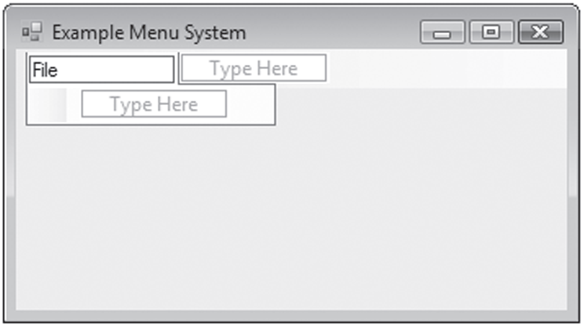
How to Use the Menu Designer
The word File has
been typed as
the text for the
first menu item
Select the box to enter the next menu item

Slide 39
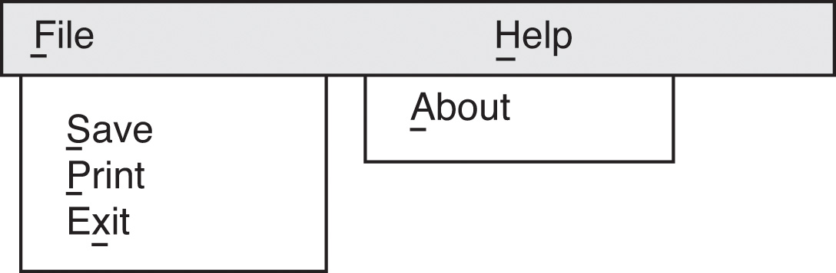
ToolStripMenuItem Object Names
It is recommended that you change the default value of the Name property so that it
Begins with the mnu prefix
Reflects the Text property and position in the menu hierarchy
mnuFile
mnuFileSave
mnuFilePrint
mnuFileExit

Slide 40
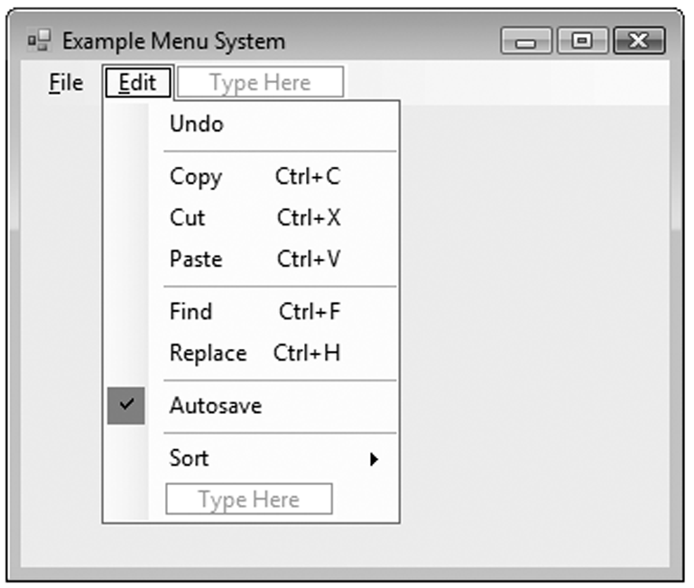
Shortcut Keys
Combination of keys that cause a menu command to execute
Ctrl + C to copy an item to the clipboard
Set with the ShortcutKeys property
Displayed only if the ShowShortcut property is set to True

Slide 41
Checked Menu Items
Turns a feature on or off
For example, an alarm for a clock
To create a checked menu item:
Set CheckOnClick property to True
Set Checked property to True if feature should be on when the form is initially displayed
If mnuSettingsAlarm.Checked = True Then
MessageBox.Show("WAKE UP!")
End If

Slide 42
Disabled Menu Items
A menu item is grayed out (disabled) with the Enabled property, for example:
Paste option is initially disabled and only enabled after something is cut or copied
Code initially disables the Paste option
Following a cut or copy, Paste is enabled
mnuEditPaste.Enabled = False
mnuEditPaste.Enabled = True

Slide 43
Adding Separator Bars
Right-click menu item, select Insert Separator
A separator bar will be inserted above the menu item
Or type a hyphen (-) as a menu item’s Text property

Slide 44
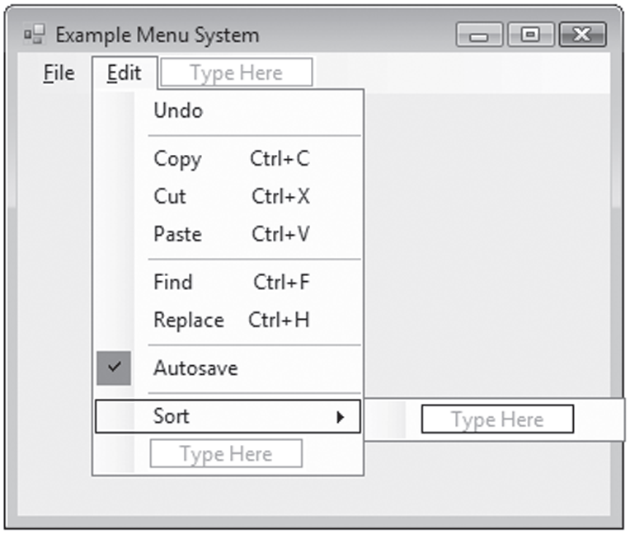
Submenus
When selecting a menu item in the designer, a Type Here box appears to the right
Begin a submenu by setting up this menu item
If a menu item has a submenu, a solid right-pointing arrow( )will be shown
Type here to add
a submenu item

Slide 45
Inserting, Deleting, And Rearranging Menu Items
To insert a new menu item
Right-click an existing menu item
Select Insert then MenuItem from pop-up menu
A new menu item will be inserted above the existing menu item
To delete a menu item
Right-click on the item
Choose Delete from the pop-up menu
Or select the menu item and press the Delete key
To rearrange a menu item
Simply select the menu item in the menu designer and drag it to the desired location

Slide 46
ToolStripMenuItem Click Event
Menus and submenus require no code
Commands must have a click event procedure
Double click on the menu item
Event procedure created in the code window
Programmer supplies the code to execute
Suppose a menu system has a File menu with an Exit command named mnuFileExit
Private Sub mnuFileExit_Click(...) Handles mnuFileExit.Click
' Close the form.
Me.Close()
End Sub

Slide 47
Standard Menu Items
Most applications to have the following menu items
File as the leftmost item on the menu strip
Access key Alt + F
An Exit command on the File menu
Access key Alt + X
Shortcut key Alt + Q (optional)
Help as the rightmost item on the menu strip
Access key Alt + H
An About command on the Help menu
Access key Alt + A
Displays an About box
Tutorial 7-5 demonstrates how to build a simple menu system

Slide 48
Context Menus
A context menu, or pop-up menu, is displayed when the user right-clicks a form or control
To create a context menu
Double-click the ContextMenuStrip icon in the Toolbox window
A ContextMenuStrip control appears in the component tray
Change the ContextMenuStrip control’s default Name property
Add menu items with the menu designer
Create click event procedures for the menu items
Associate the context menu with a control
Set the control’s ContextMenuStrip property to the name of the ContextMenuStrip control

Slide 49
Focus on Problem Solving: Building the High Adventure Travel Agency Price Quote Application
Section 7.4
In this section you build an application for the High Adventure
Travel Agency. The application uses multiple forms, a module,
and a menu system.

Slide 50
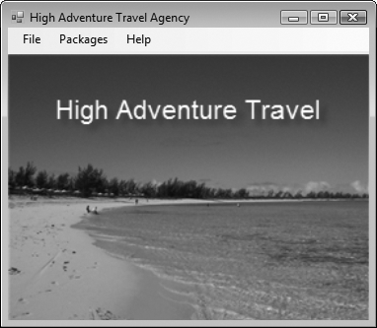
The MainForm Form

Slide 51
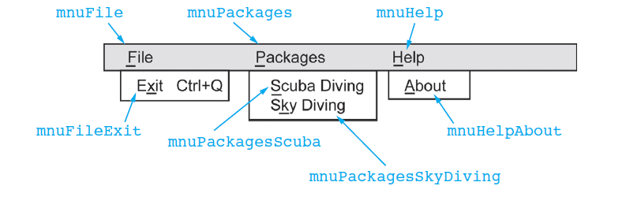
The MainForm Menu System

Slide 52
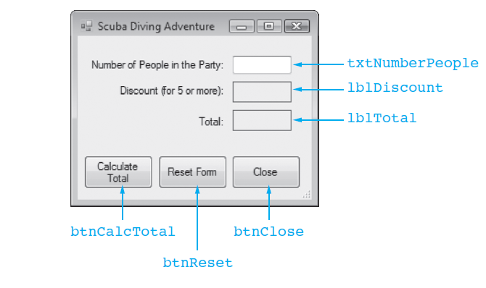
The ScubaForm Form

Slide 53
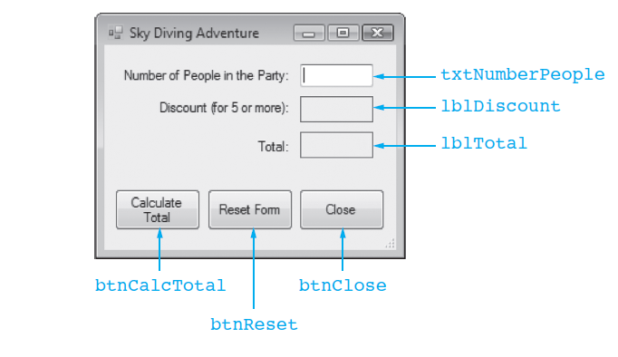
The SkyDiveForm Form

Slide 54
The PriceCalcModule Module
1 Module PriceCalcModule
2 ' Global constants
3 Public Const g_intMINIMUM_FOR_DISCOUNT As Integer = 5
4 Public Const g_decDISCOUNT_PERCENTAGE As Decimal = 0.1D
5
6 ' The DiscountAmount function accepts a package total
7 ' as an argument and returns the amount of discount
8 ' for that total.
9
10 Public Function DiscountAmount(ByVal decTotal As Decimal) As Decimal
11 Dim decDiscount As Decimal ' To hold the discount
12
13 ' Calculate the discount.
14 decDiscount = decTotal * g_decDISCOUNT_PERCENTAGE
15
16 ' Return the discount.
17 Return decDiscount
18 End Function
19 End Module

